Slide 1
Introduction to Design Patterns
Alex Beyderman
Software developer

Slide 2
Design Pattern are:
Template for how to solve a problem or implement an idea in source code.
Generally reusable solution of a common problem.

Slide 3
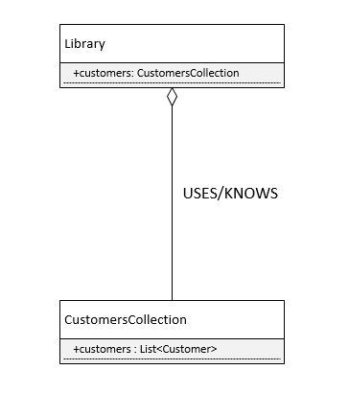
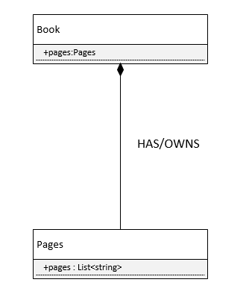
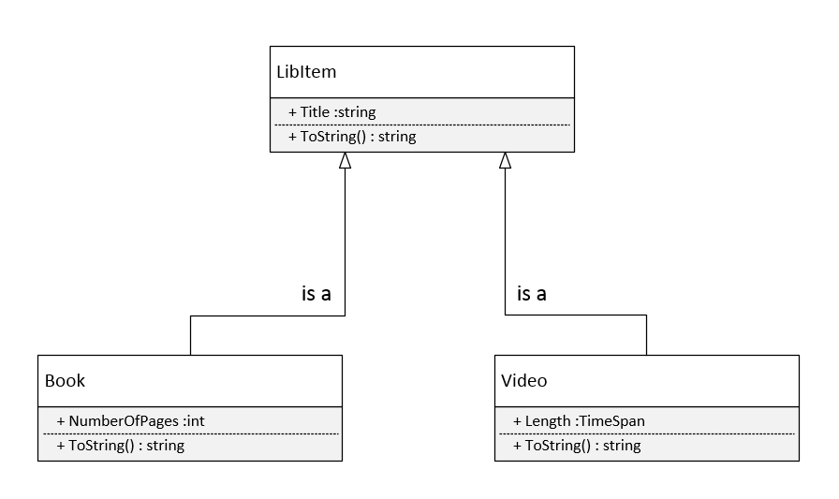
Unified Modeling Language in (very)nutshell
Aggregation
Composition
Inheritance

Slide 4
Unified Modeling Language in (very)nutshell
Inheritance
Composition
Aggregation

Slide 5
S.O.L.I.D.
Single Responsibility principle (SRP)
Open/closed principle (OCP)
Liskov substitution principle (LSP)
Interface segregation principle (ISP)
Dependency inversion principle (DIP)

Slide 6
3 Design patterns types
Creational – designed to abstract instantiation process.
Structural – concerned with how two or more objects are composed into a bigger object.
Behavioral – dealing with algorithms and assigning responsibility between objects.

Slide 7
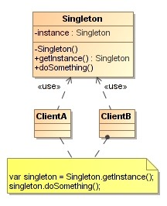
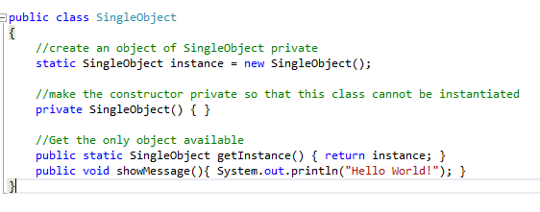
Singleton (creational)
Forces a developer to use only ONE instance of an object for current application life span.
Define
UML

Slide 8
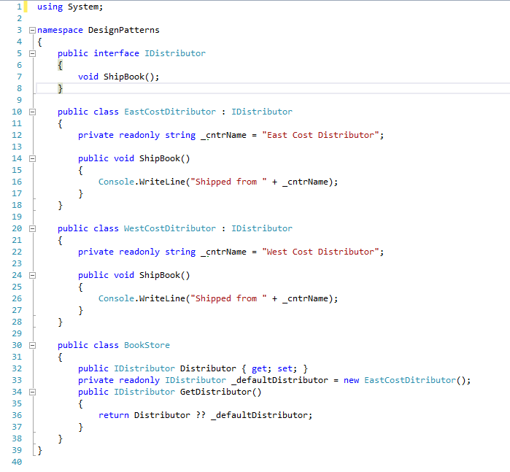
Factory (creational)
Object which acts as creator of other objects implementing same interface

Slide 9
Bridge (structural)
Enables use of different APIs by same type of object
Works like “API injector”

Slide 10
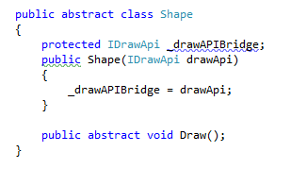

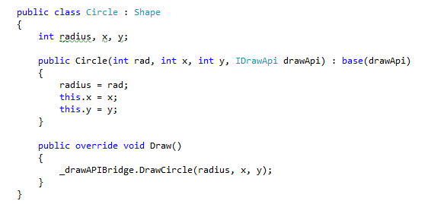
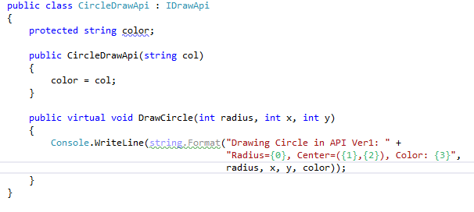
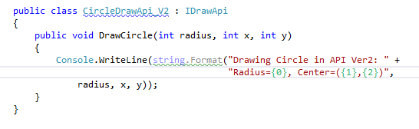
Bridge – practical example

Slide 11
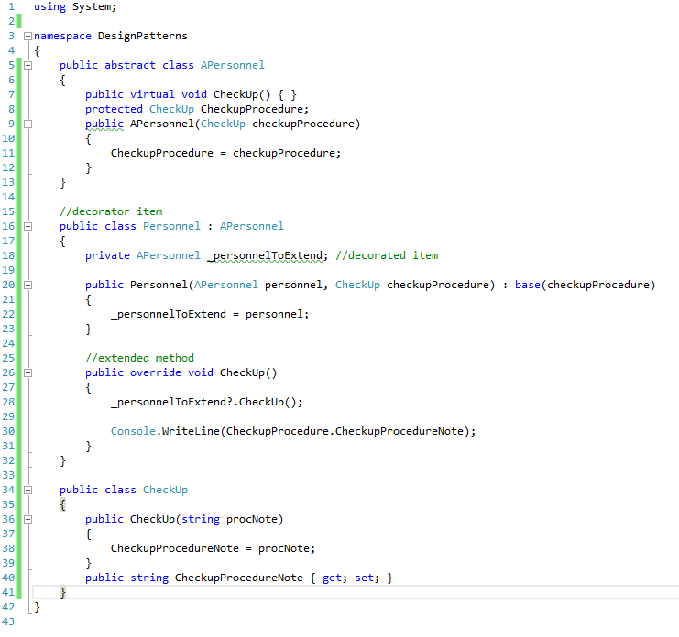
Decorator (structural)
Extends (decorates) an object’s functionality

Slide 12
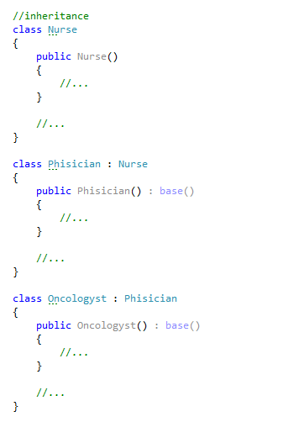
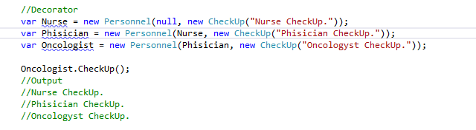
Decorator vs. Inheritance – what’s better?

Slide 13
Visitor (behavioral)
Represent an operation to be performed on different objects without changing the objects

Slide 14
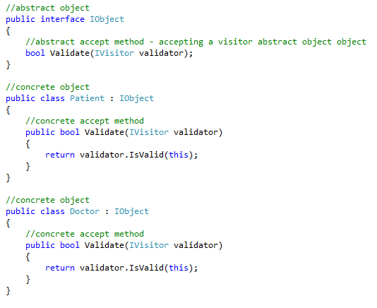
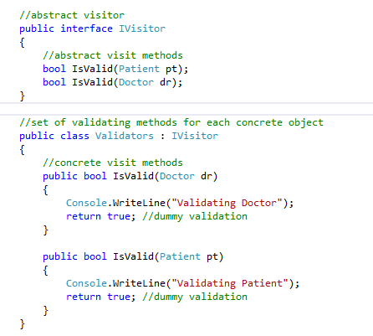
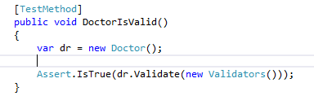
Visitor - example

Slide 15
Q&A

Slide 16
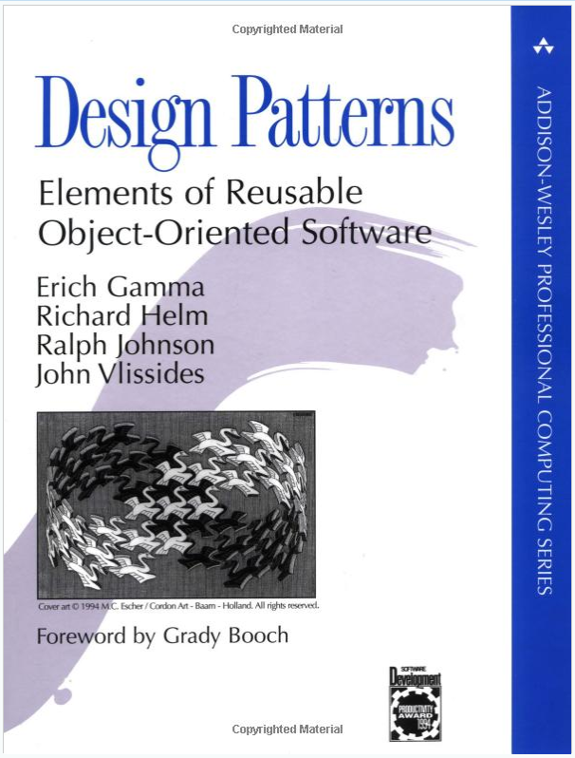
Resources
https://sourcemaking.com/design_patterns
http://www.dofactory.com/net/design-patterns

Slide 17
Exercises

Slide 18
Instructions
Clone the Exercise project from https://github.com/VarianDeveloper/Jan2017_DesignPatternsTraining.git
For GitHub Quick start refer to https://github.com/VarianDeveloper/Jan2017_DesignPatternsTraining/blob/master/Documents/GitHubQuickStart.docx

Slide 19
Part1 – Implement Library main engine
Given:
main method which starts Library application
Task:
Using Singleton pattern make sure the system will always run only one instance of library

Slide 20
Part2 - Implement part of a library registration system
Given:
Book class extending LibItem abstract class
Video class extending LibItem abstract class
Customer class extending Person abstract class
Task:
Using Bridge pattern implement Registration class that adds new book, video or customer to the library.

Slide 21
Part3 - Implement part of a library tracking system
Given:
Book class extending LibItem class
Video class extending LibItem class
Task:
Using Decorator pattern implement BookBorrowable class that enables to borrow a book from the library.

